Slide 1
TECH SAVVY & ETHICALLY SMART RAD
MAAME FOSUA AMPOFO
GSR ZONAL CONFERENCE,
1ST APRIL 2023

Slide 2
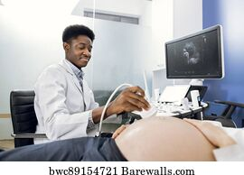

Slide 3
Are you moving with Technology?
Radiographers have always needed to embrace change.
Radiography is a rapidly advancing profession.
Flexibility is an essential attribute as new technology and ways of working are introduced

Slide 4
Do really know to day’s patient?
Today’s patients are more sophisticated than a few decades ago.
They are more bold because;
they know their rights
more access to information about their illness
they know what to expect
they know where to seek redress

Slide 5
Do you know?
As professionals we have Ethical duties towards;
The Patient
Other health professional
society
Environment
Self

Slide 6
Duties to the Patient
The patients’ best interest should be of primary importance.

Slide 7
Perform only the procedures for which you are Trained
What have you been trained in?
What are you proficient in?
Will you need assistance in a procedure?
Please seek help when necessary

Slide 8
Advocate the most appropriate care for patients
Ensure that a patient entrusted to you receive the most appropriate care

Slide 9
Personal prejudices must not affect professional relationship
This is “differences in the quality of healthcare that is not due to access-related factors or clinical needs, preferences, and appropriateness of intervention.”
A person’s level of poverty, education, religion, culture or race should not affect the quality of care they receive from us .

Slide 10
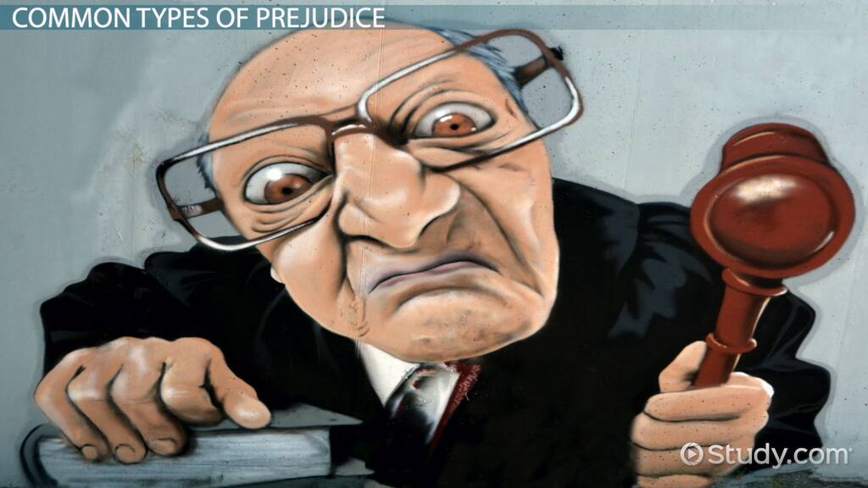

Slide 11
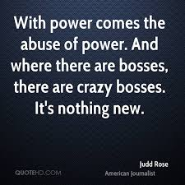
ABUSE OF POWER, what does it mean?

Slide 12
Do not abuse the power entrusted in you as a professional
Abuse of power is the misuse of our position as professionals to take unjust advantage of patients i.e. physically, emotionally financially and sexually
Condescending reactions to patients questions.
Replace therapeutic/diagnostic goals with exploitative goals, sexual or otherwise.

Slide 13
Practice the principles of justification, optimization and ALARA.
A – As
L – Low
A – As
R – Reasonably
A – Achievable

Slide 14
Respect and maintain patient privacy and confidentiality at all times
Cover patient properly during examination
For ultrasound examinations, area under examination must be exposed in a dignifying manner.
do not walk in and out of the changing room when patient is changing.

Slide 15
Access to patients details must be limited to only relevant people.
Minimize the number of staff moving in and out of examination room whiles patient is in there
Respect and maintain patient privacy and confidentiality at all times

Slide 16
Facilitate and support the free and informed choices of patients, families, or caregivers, including decisions to refuse or withdraw from imaging and/or treatment.

Slide 17
Ensure the principle of informed consent is upheld throughout the patient’s experience.
At what stages in the examination do we need patients’ consent?

Slide 18
Do all patients deserve same treatment?
Treat all individuals with respect and dignity.
Provide care regardless of race, national or ethnic origin, colour, gender, sexual orientation, religious or political affiliation, age, type of illness, mental or physical ability.

Slide 19
Provide information
Educate patients, families, and caregivers by providing information that can be understood and used to make informed decisions about their care.

Slide 20
Answer Questions Honestly
Seek additional information or refer the patient to the most appropriate healthcare provider.
Answer questions fully and honestly within the limits of your knowledge, authority, and responsibility

Slide 21
Respect patients’ rights.
What rights of patients can you remember off head?
Do you know the Patients Chatter?

Slide 22
Facilitate patients care
Collaborate and consult with patients, appropriate decision-makers, and healthcare providers to facilitate optimal patient care.
Does the patients’ history correspond to the request?
Is cholecystitis being queried whiles Pelvic scan is requested?

Slide 23
See Something, Say Something
Intervene in circumstances of abuse or unsafe, incompetent, or unethical practice.

Slide 24
THANK YOU

