Slide 1
Achieving person-centred diagnostic imaging services in low-and middle-income countries: barriers and strategies
Alberta Naa Afia Adjei¹, Andrew Donkor^{1,2}, Yaw Amo Wiafe¹
Department of Medical Diagnostics, Faculty of Allied Health Sciences, Kwame Nkrumah University of Science and Technology, Kumasi, Ghana
IMPACCT, Faculty of Health, University of Technology Sydney, Australia

Slide 2
Content
Introduction
Low-and-middle income country
Person centered diagnostic imaging care
Barriers and strategies in person centered diagnostic imaging care
Conclusion
References

Slide 3
Introduction
Low-and-middle income countries, gross national income(GNI) per capita is $13,205 or less.
A total 136 countries: 28 low-income ($1,085 or less)
54 lower-middle-income ($1,086 to $4,255)
54 upper –middle-income ($4,256 to $13,205)
(World bank group, 2023)

Slide 4
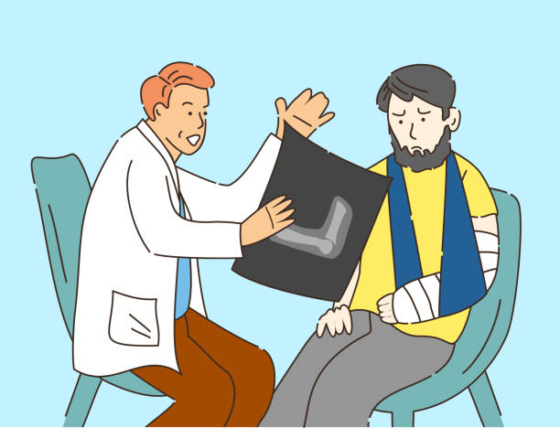
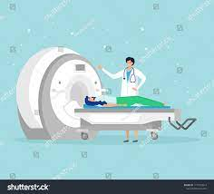
Person-centered diagnostic imaging care
Key elements:
Treating patients as individuals;
Recognising that all individuals accessing diagnostic imaging
services have a unique clinical history, physical, social and economic needs;
Recognising that individuals accessing diagnostic imaging services need a comfortable environment;
Communicating effectively with each individual; and
Respecting the dignity, privacy and confidentiality of individuals accessing diagnostic imaging services.

Slide 5
Useful lessons for person centered care
Strengthening partnerships to increase access to diagnostic imaging services
Providing leadership to improve responsiveness
Promoting diagnostic imaging information and education through improvement in patients’ health literacy
Developing and allocating diagnostic radiographers to promote quality and safety

Slide 6
Barriers and Strategies

Slide 7
5 A’s of access
Access is the ability of the client to seek and obtain safe and high-quality diagnostic imaging services. Diagnostic imaging services should be organised and delivered according to the preferences, needs and values of the individual patient.
Levesque framework

Slide 8
Access barriers
Based on the Levesque framework, access barriers include:
Availability and accommodation problems
Affordability problems
Acceptability problems
Approachability problems
Appropriateness problems

Slide 9
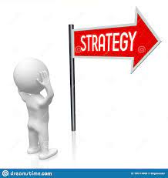
Strategies to improve access
Strengthening partnerships to increase access to diagnostic imaging services
Partnership with private and charitable sectors
Proper planning for equipment distribution
Approachable and affordable services

Slide 10
Responsiveness
Responsiveness involves the experience of patients’ interactions with their health systems, which confirms or disconfirms their initial expectations (Mirzoev & Kane, 2017).
It is a key outcome on which health systems, including diagnostic imaging services, are judged.

Slide 11
Barriers to responsiveness
Responsiveness
Lack of respect for autonomy
Lack of prompt attention
Lack of adequate confidentiality
Poor quality of basic amenities

Slide 12
Strategies to improve responsiveness
The six point leadership framework of South Western Sydney Local Health District
Setting direction
Developing self
Developing and enabling others
Fostering and building positive relationships
Communicating with influence
Innovating and leading change
(SWSLHD, 2017).

Slide 13
Patient information and education
Health literacy has been defined as the capacity of an individual to access, process and comprehend health information and services required to make effective health decisions (Sørensen et al., 2012).
Many patients in LMICs report difficulties in obtaining relevant information about their diagnostic imaging procedures.

Slide 14
Poor patient-centered communication
Lack of patient educational resources
Lack of knowledge on diagnostic imaging and its related benefits
Barriers to patient information and education
Patient information

Slide 15
Window of opportunities for patient education
Due to busy schedules of radiographers and patients, radiographers can take opportunities for patient information and education:
During the explanation of the diagnostic imaging procedures;
When responding to the patient concerns;
As part of the instructions needed to prepare for the diagnostic imaging procedure; and
During instruction for follow-up care.
(Ehrlich & Coakes, 2020).

Slide 16
Strategies for patient information and education
Training interventions should be designed to improve diagnostic imaging professionals’ communication skills to help involve patients in their diagnostic imaging care.
Communication frameworks such as AIDET, RESPECT and PREPARED can be adopted in such instances.

Slide 17
PREPARED
P- Prepare for the discussion
R- Relate to the person
E-Elicit patient and caregiver preferences
P- Provide information
A- Acknowledge emotions and concerns
R- Realistic hope
E- Encourage questions
D- Document
(Clayton, Hancock, Butow, Tattersall, & Currow, 2007; Mutha, Allen, & Welch, 2002; Studer Group, 2010)

Slide 18
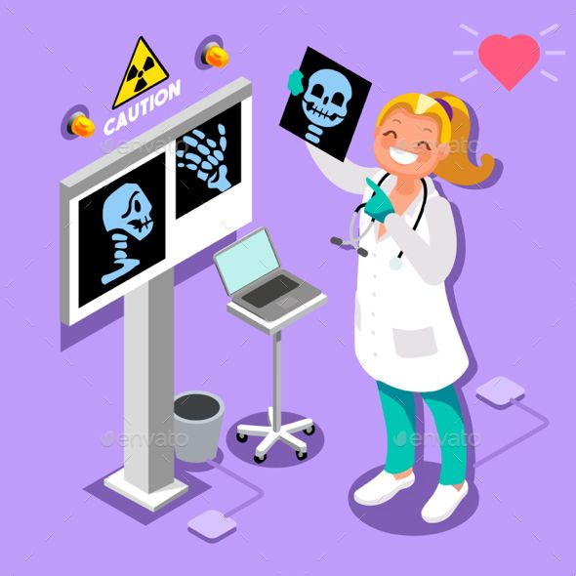
Diagnostic imaging workforce
The diagnostic imaging workforce challenges in LMICs are complex and multifaceted. Demand for diagnostic imaging services is evolving rapidly and continues to challenge the diagnostic radiographers’ ability to deliver safe and high-quality services in LMICs.

Slide 19
Barriers to diagnostic imaging workforce

Slide 20
Barriers to diagnostic imaging workforce
Lack of coordination in diagnostic radiography workforce planning
Inequitable distribution of diagnostic radiographers
Changing models of technology on patient care

Slide 21
Strategies for workforce
Formal relationships should be built between urban and rural diagnostic imaging facilities to rotate training students and build local capacity
Incentive and non-incentive strategies should be designed to encourage diagnostic imaging professionals to locate and remain in rural areas
Fellowship training in diagnostic radiography can improve the confidence of diagnostic radiographers and their preparedness to assume leadership level of responsibility as specialists and consultants

Slide 22
Conclusion
It can be seen that the barriers are complex. However, by strengthening partnerships, providing leadership, promoting health literacy and investing in the training of diagnostic radiographers, person-centred diagnostic imaging care can be achieved in LMICs.
There is also the need to understand how well integrated person-centred care has become in the education, training and core competences of diagnostic imaging professionals.

Slide 23
References
Clayton, J. M., Hancock, K. M., Butow, P. N., Tattersall, M. H., & Currow, D. C. (2007). Clinical practice guidelines for communicating prognosis and end-of-life issues with adults in the advanced stages of a life-limiting illness, and their caregivers. The Medical Journal of Australia, 186(12), S77-S108.
Ehrlich, R., & Coakes, D. (2020). Patient care in radiography: with an introduction to medical imaging (10 ed.). Missouri: Elsevier.
Levesque, J.-F., Harris, M. F., & Russell, G. (2013). Patient-centred access to health care: conceptualising access at the interface of health systems and populations. International Journal for Equity in Health, 12(1), 18-26. doi:10.1186/1475-9276-12-18
Mirzoev, T., & Kane, S. (2017). What is health systems responsiveness? Review of existing knowledge and proposed conceptual framework. BMJ Global Health, 2(4), e000486-e000496. doi:10.1136/bmjgh-2017-000486
Mutha, S., Allen, C., & Welch, M. (2002). Toward culturally competent care: a toolbox for teaching communication strategies. San Francisco, CA: Center for the Health Professions, University of California.

Slide 24
References cont.
Sørensen, K., Van den Broucke, S., Fullam, J., Doyle, G., Pelikan, J., Slonska, Z., & Brand, H. (2012). Health literacy and public health: a systematic review and integration of definitions and models. BMC Public Health, 12(1), 1-13.
Studer Group. (2010). The nurse leader handbook (1 ed.). Parkway: Fire Starter Publishing.
SWSLHD. (2017). Our leadership strategy: A shared approach to leadership 2017-2021. Sydney: ZEST Health Strategies.
World Bank Group. (2023). World Bank country and lending groups. Washington, D.C: The World Bank Group Retrieved from https://datahelpdesk.worldbank.org/knowledgebase/articles/906519-world-bank-country-and-lending-groups

